Slide 1

Employer Project
By:
Daniel Pattison
Christian Shupe
Kenneth Carrillo

Slide 2
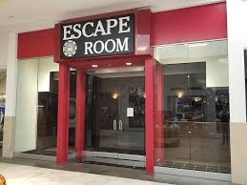


Situational Analysis
Expand Exodus (goal is to have 10 locations by 2021)
5 locations currently
How can we produce more revenue for the company?
What should we be looking for?

Slide 3

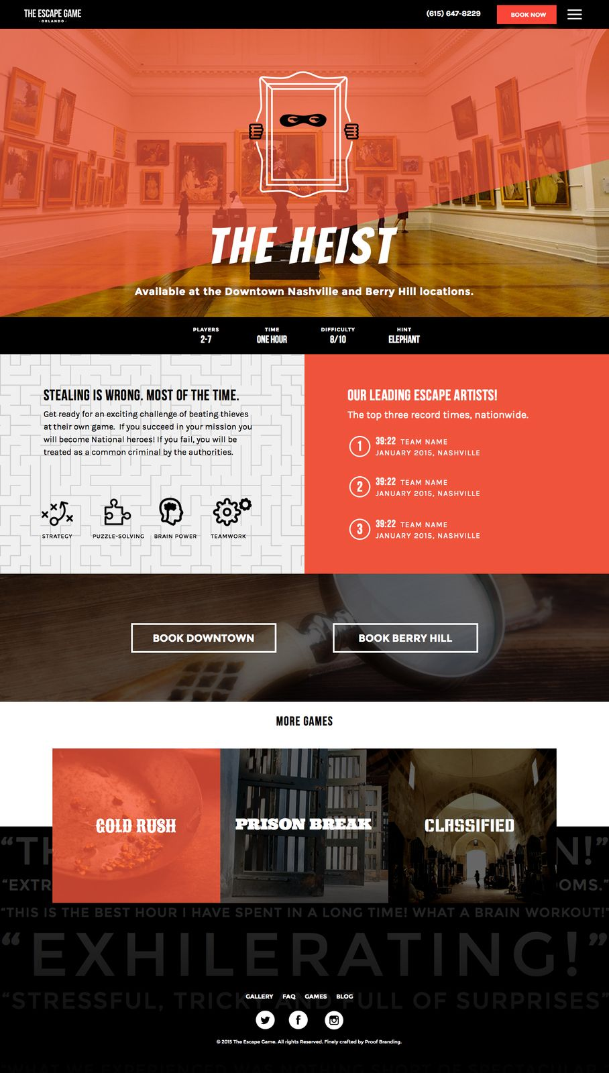
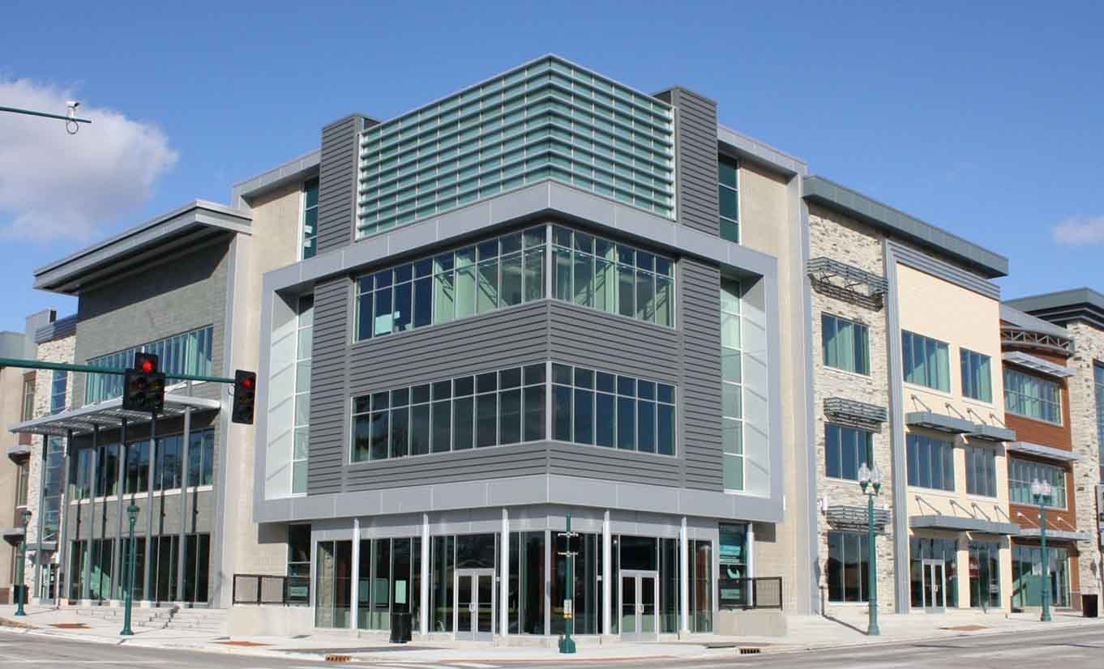
Press Release
Our team strategy is to cold call potential sellers
Look for failing escape rooms (Yelp, company website,etc.)
Searching in areas that best fit the Exodus Games
Areas that relate to their target market

Slide 4
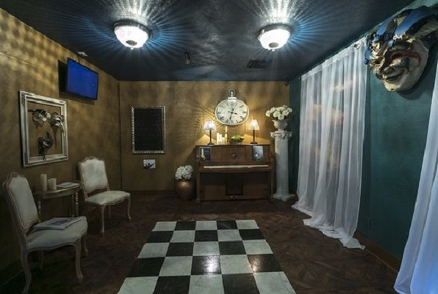
Process
Discovery
  Exodus needs more locations because they want to expand their business
Interpretation
  Find escape rooms that are failing in their market or willing to sell
Ideation
  Why are they failing? What can we do better?
Experimentation
  Many conversations with various stores, leading to potential purchases for Exodus
Evolution
  Learning what it takes to open locations and expand an organization
  Opening additional locations will financially expand Exodus

Slide 5
What Worked and What Did NOT
What worked:
Cold calls (Mom and Pop locations)
Communication with owner of Exodus
Extensive research
Follow up
What Did Not:
Contacting successful companies
Covid-19 repercussions

Slide 6
If We Had a Second Chance...
IG This project proved to be good experience for all of us.
Like all groups, problems arose that we tried to make adjustments to.
Time Challenges
Group consisted of 3 full time seniors who were also employed.
If we had a second chance, I think we could plan a week ahead. Although not ideal in an industry where one has to pounce quick, it would at least be established in our mental calendar.
Cancel the Coronavirus.
The virus shut down various industries and non-essential businesses.
Had we known a shutdown was imminent, we would have pushed harder.

Slide 7
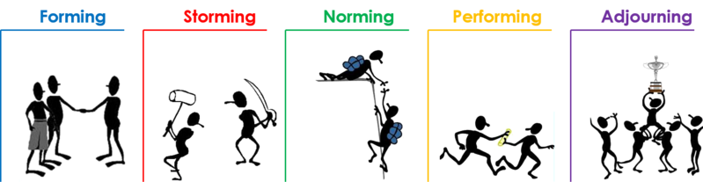
Team Dynamics

Slide 8
Team Dynamics
Throughout the process, the team went through the different stages of forming, storming, norming, and performing.
Forming: We formed through signing up for these groups.
We made a group chat and set up a meeting with Chad.
Storming: Chad let us know more on the company.
We discussed different ideas suggestions.
Norming: We came together and picked an idea.
We knew our roles going into the project.
Performing: We made a document and set up a game plan.
We also listed locations we are looking at, with contact info.
Adjourning: COVID-19 affected the market on this industry.
Difficulties arose in reaching out and measuring profitability.

Slide 9

Faith Integration
Exodus 35:35 - He has filled them with skills to do all kinds of work as engravers, designers, embroiderers in blue, purple, and scarlet yarn and fine linen, and weavers - all of them skilled workers and designers
Isaiah 40:29-31 - He gives strength to the weary and increases the power of the weak. Even youths grow tired and weary, and young men stumble and fall; but those who hope in the Lord will renew their strength. They will soar on wings like eagles; they will run and not grow weary, they will walk and not be faint.

Slide 10
Notes from Our Project
https://docs.google.com/document/d/1mTVpNZh9RViuXy7i5qp8N_1tpABbaRRtvn187tB1o5U/edit?usp=sharing

