Slide 1
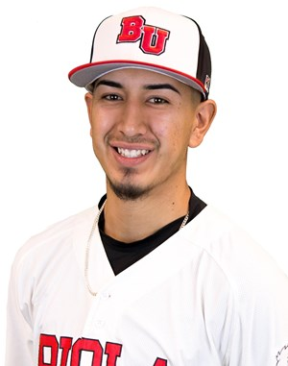

Brand You:
Kenny Carrillo

Slide 2

Unique Selling Proposition (USP)
What separates me from the rest of the business managers?
What I value the most is trust with other people.
I realize that employees work with me, not for me.
There is always room to grow. This involves the ability to be open to criticism. There is always room for improvement.
I value the little wins and recognize they are signs of one moving in the right direction.
I value my ability to influence more than having authority.
There is always an open door policy.

Slide 3
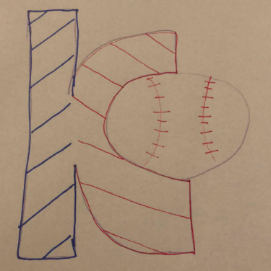
Logo
My logo is my initials mixed in with a baseball,
the sport I currently play and am dedicated to.

Slide 4
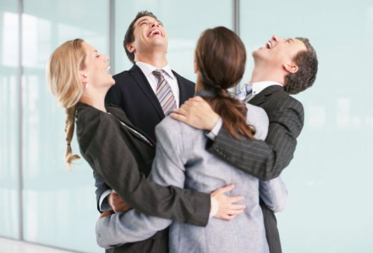
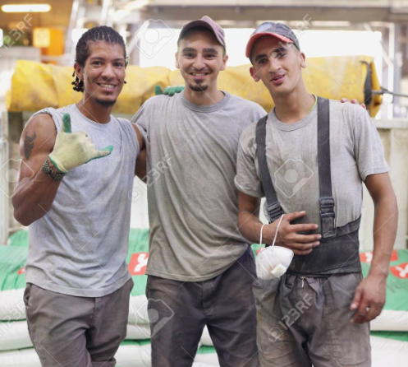
Tagline
“It’s more than just work.”

Slide 5


Trigger Terms & Words
Uplifting
Commitment
Leadership
Independent
Easy to get along with
Confident
Courageous
Hard working

Slide 6
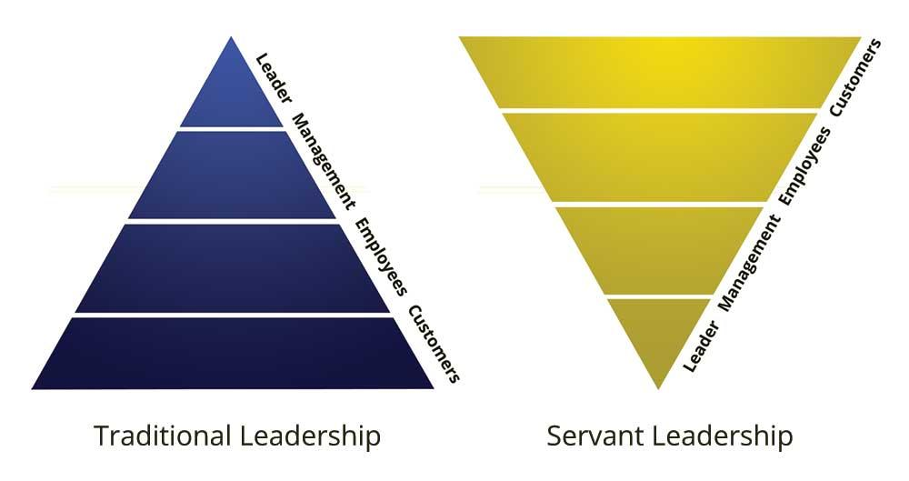
Benefits
How will I add value to others?
My work is dedicated to helping others, so I will always strive to lift up others around me.
Playing sports for most of my life, I realize what it takes to work well with teams, as well as leading a group of people.
Being a servant leader, I know my work is only as valuable to myself as it is to others around me.
I hope people are able to say they were able to exceed their own expectations when working with me.

Slide 7


Brand Management
I hope to establish my brand through experience in the workplace. I hope to experience a plethora of different positions or assignments within the position in order to grow.
As established previously, I am always trying to improve. This can be done with a lot of work experience, as well as receiving and adjusting to feedback.

Slide 8

Brand Association
What images/pictures do you want to pop into people’s minds when they hear your name?
I want people to think of a bright blue sky-like color. I aim for a bright color because I want to have a bright impact on others.
I would also want people to associate me with the sun, as brightness would establish a sense of positivity and delightfulness.

Slide 9
Board of Directors
Jeff Calhoon - jeff.calhoon@biola.edu
Manny Arana - arana_manny@montebello.k12.ca.us
Ben Cordy - benjamin.cordy@biola.edu
John Berumen - johnberumen@impactplayerbaseball.com
Nate Blea - nateblea@impactplayerbaseball.com

Slide 10
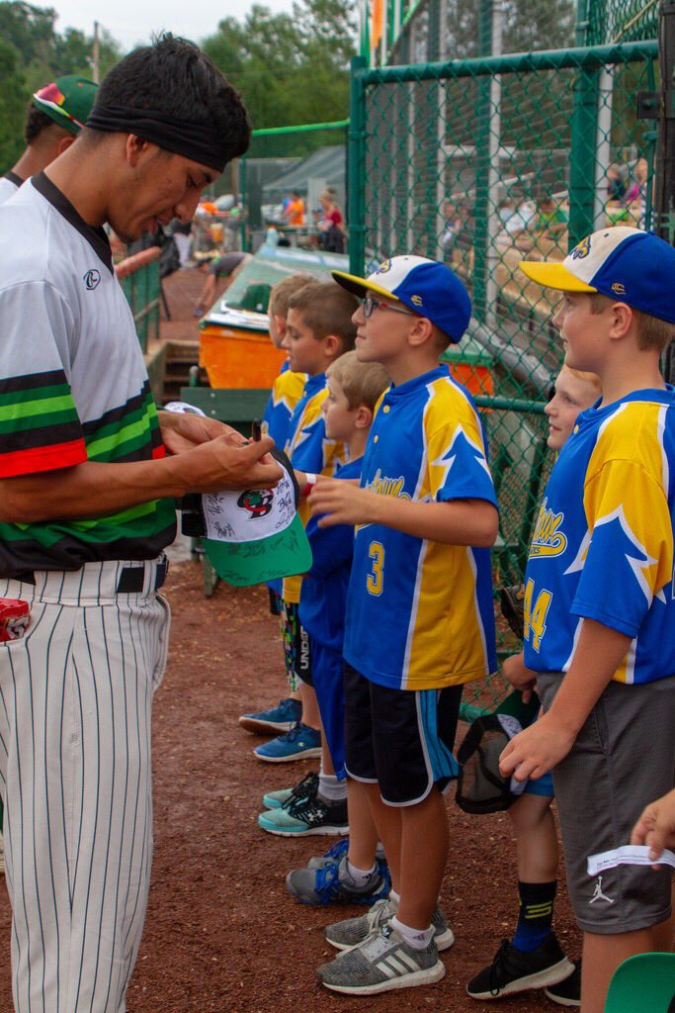
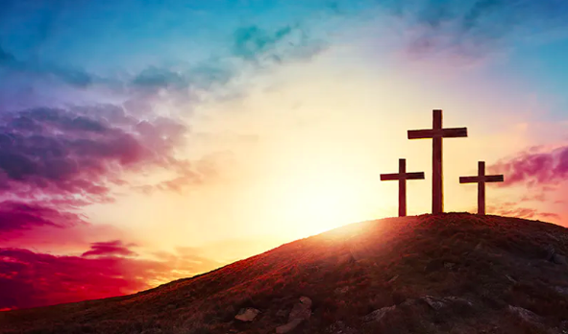
Core Values
There are a variety of values I have as an aspiring manager, but my top 5 are the ones that have become second nature when working with others. In no particular order, they are:
Establish trust.
Create a culture.
Be a servant leader- serve before being served.
Seek growth and development over results.
Put God first.

Slide 11


Brand Promise
What is my brand promise, and what do I commit to delivering to an organization?
Features: I always bring a positive and hardworking energy in everything that I do.
Functions: I am able to commit to a task and make sure I find a way to finish it within a given time period.
Rewards: I present the ability to get any task done that will benefit others.
Values: I am a servant leader who serves others before myself.
Personality: I am someone who strives to bring the best out of everyone I work with.

Slide 12
Thank you for your time!

