Slide 1
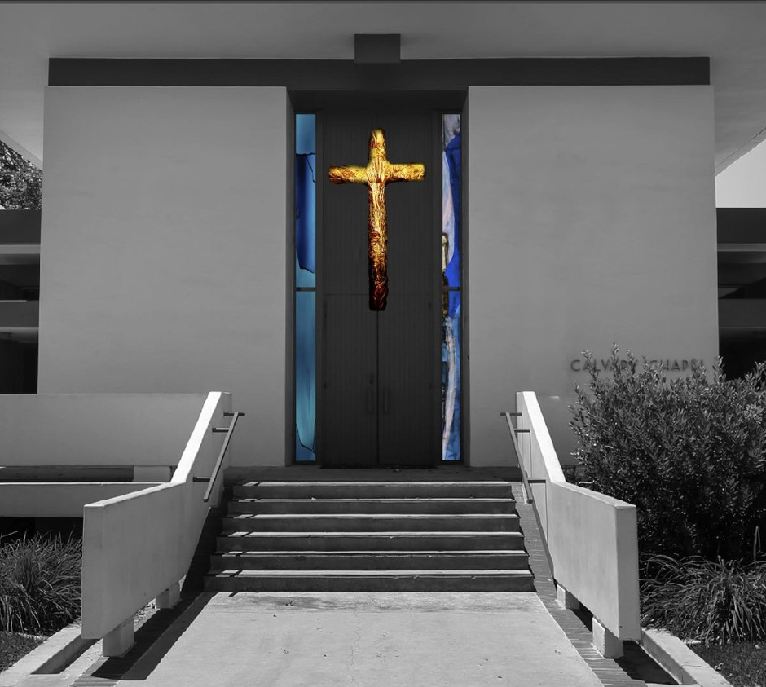
Design Thinking Project
Guillermo Alcantar Kenneth Carrillo
Elijah Delos Reyes Jeffrey Sarwono

Slide 2
Problem / Challenge:
Being required to go to Chapel has been a problem for many students. People are not engaged in Chapel, people are trying to skip chapel, and people are just paying the fine.

Slide 3
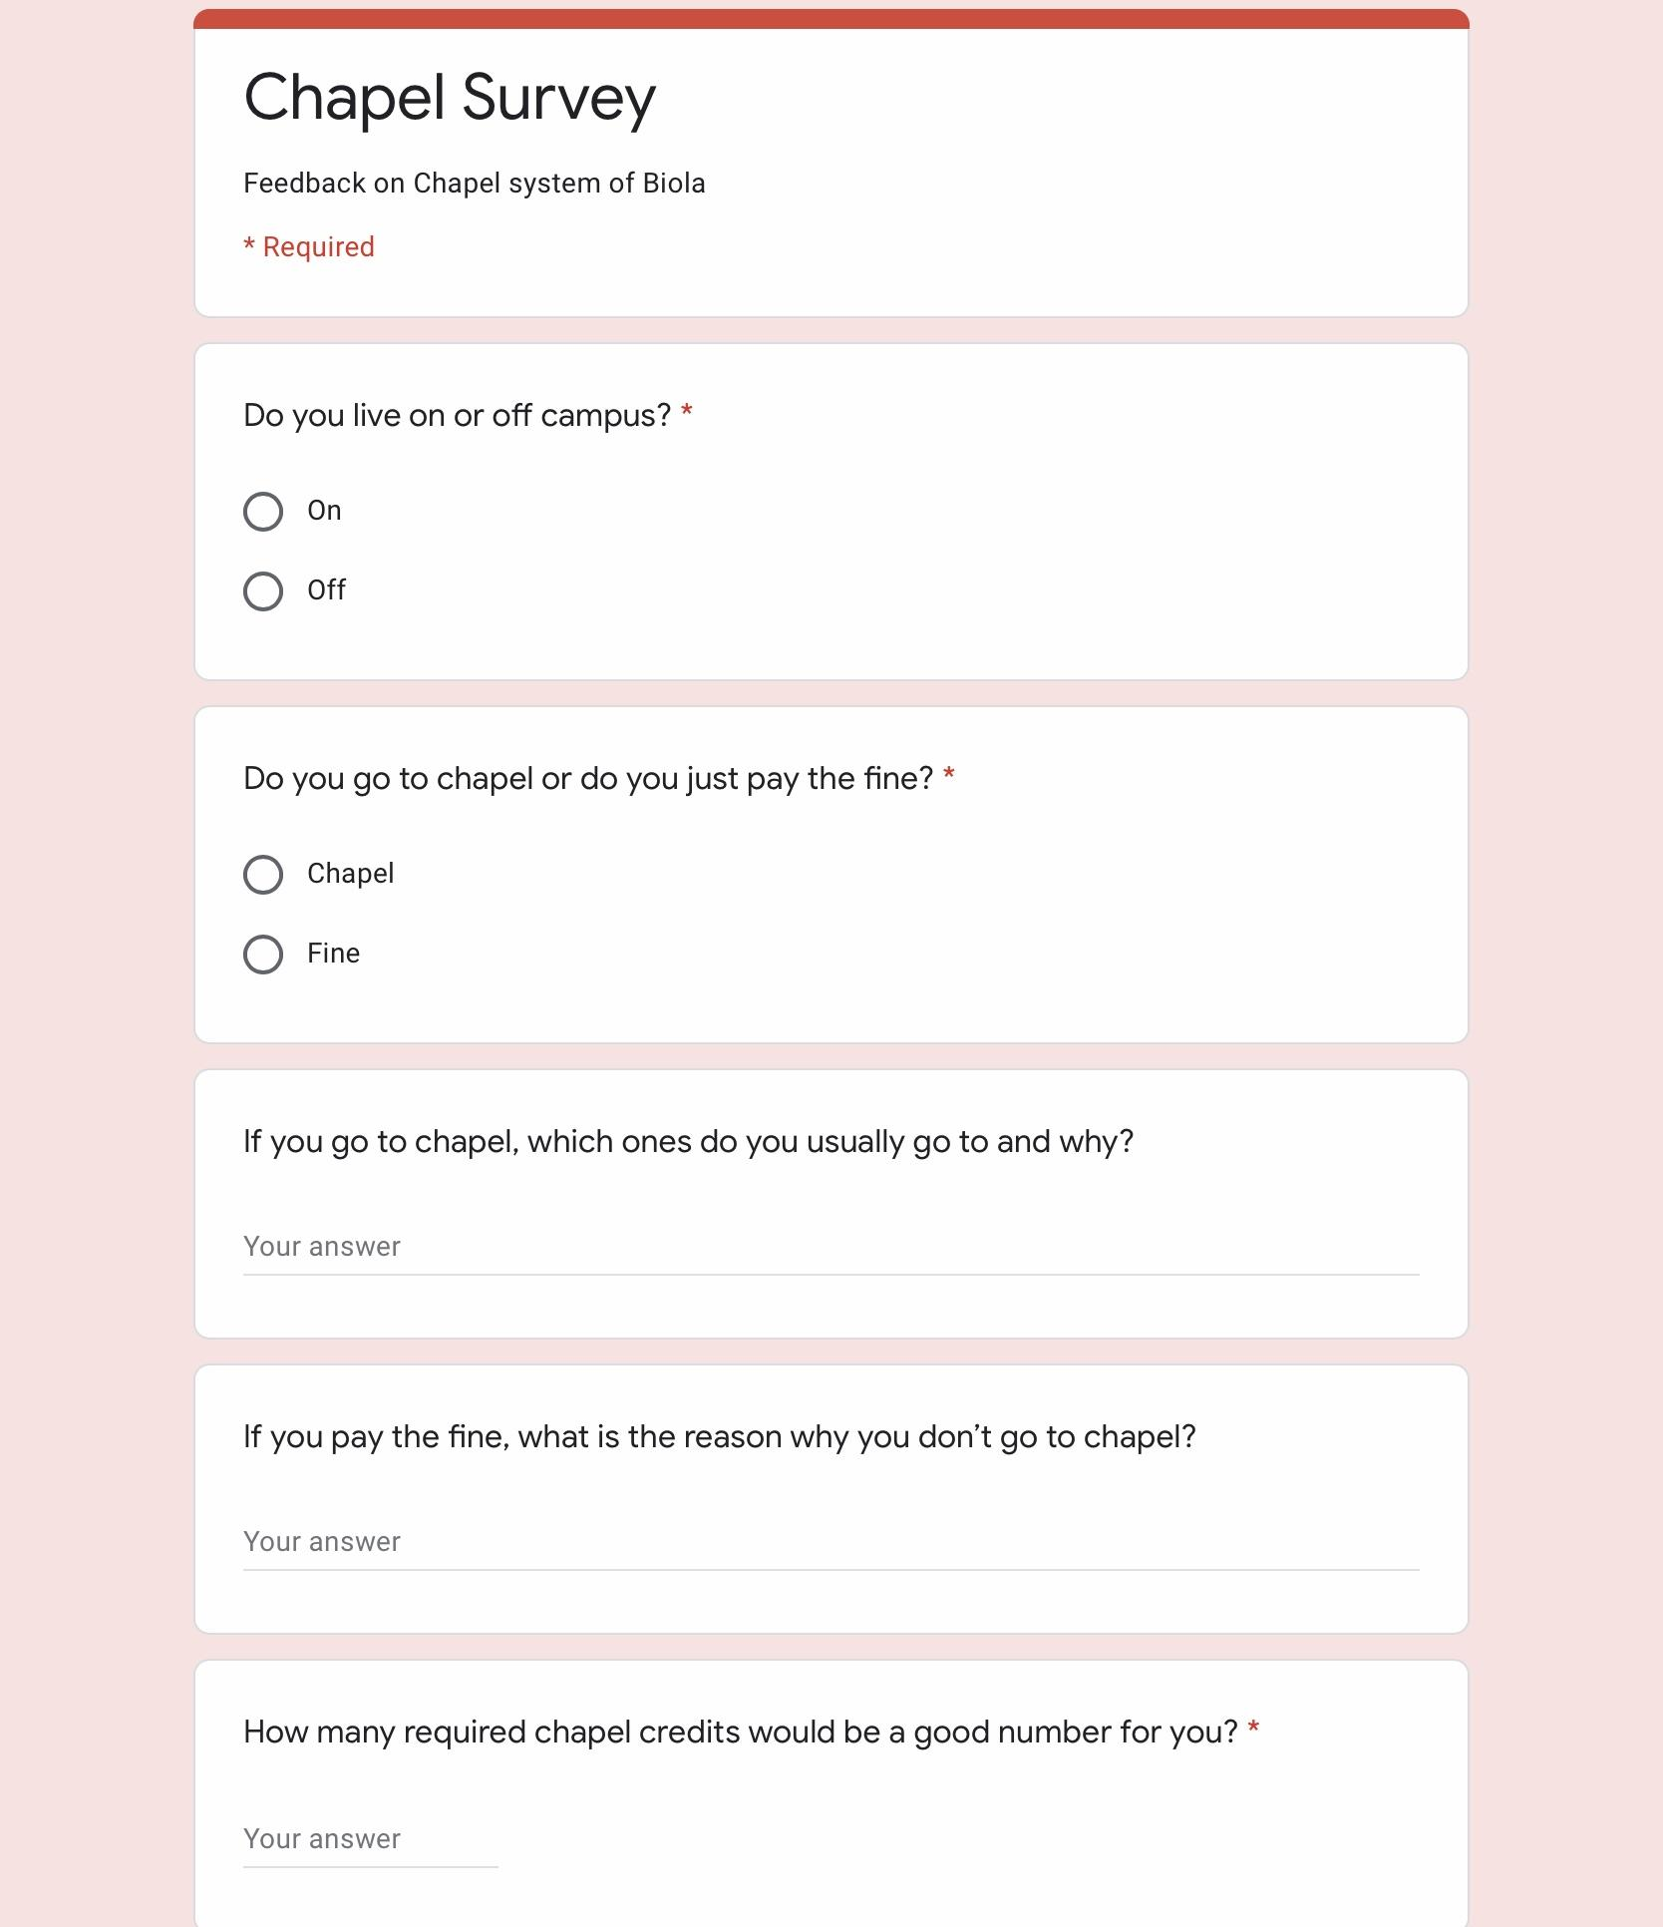

Step 1: Discovery
Survey
Google Forms
Notes:
Mention about human center research
We want to do a human centered research thus we made a google form ….

Slide 4
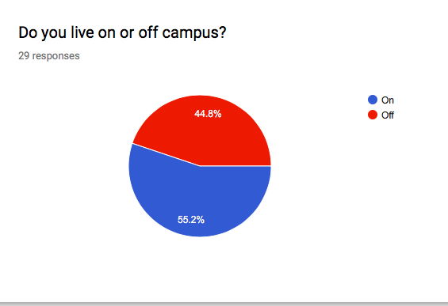
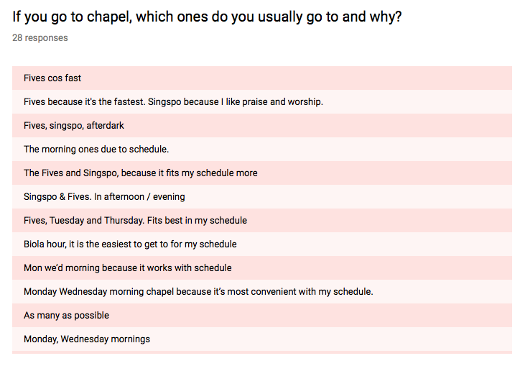
Step 1: Discovery
Notes:
On or off campus to see if location affected chapel behavior

Slide 5
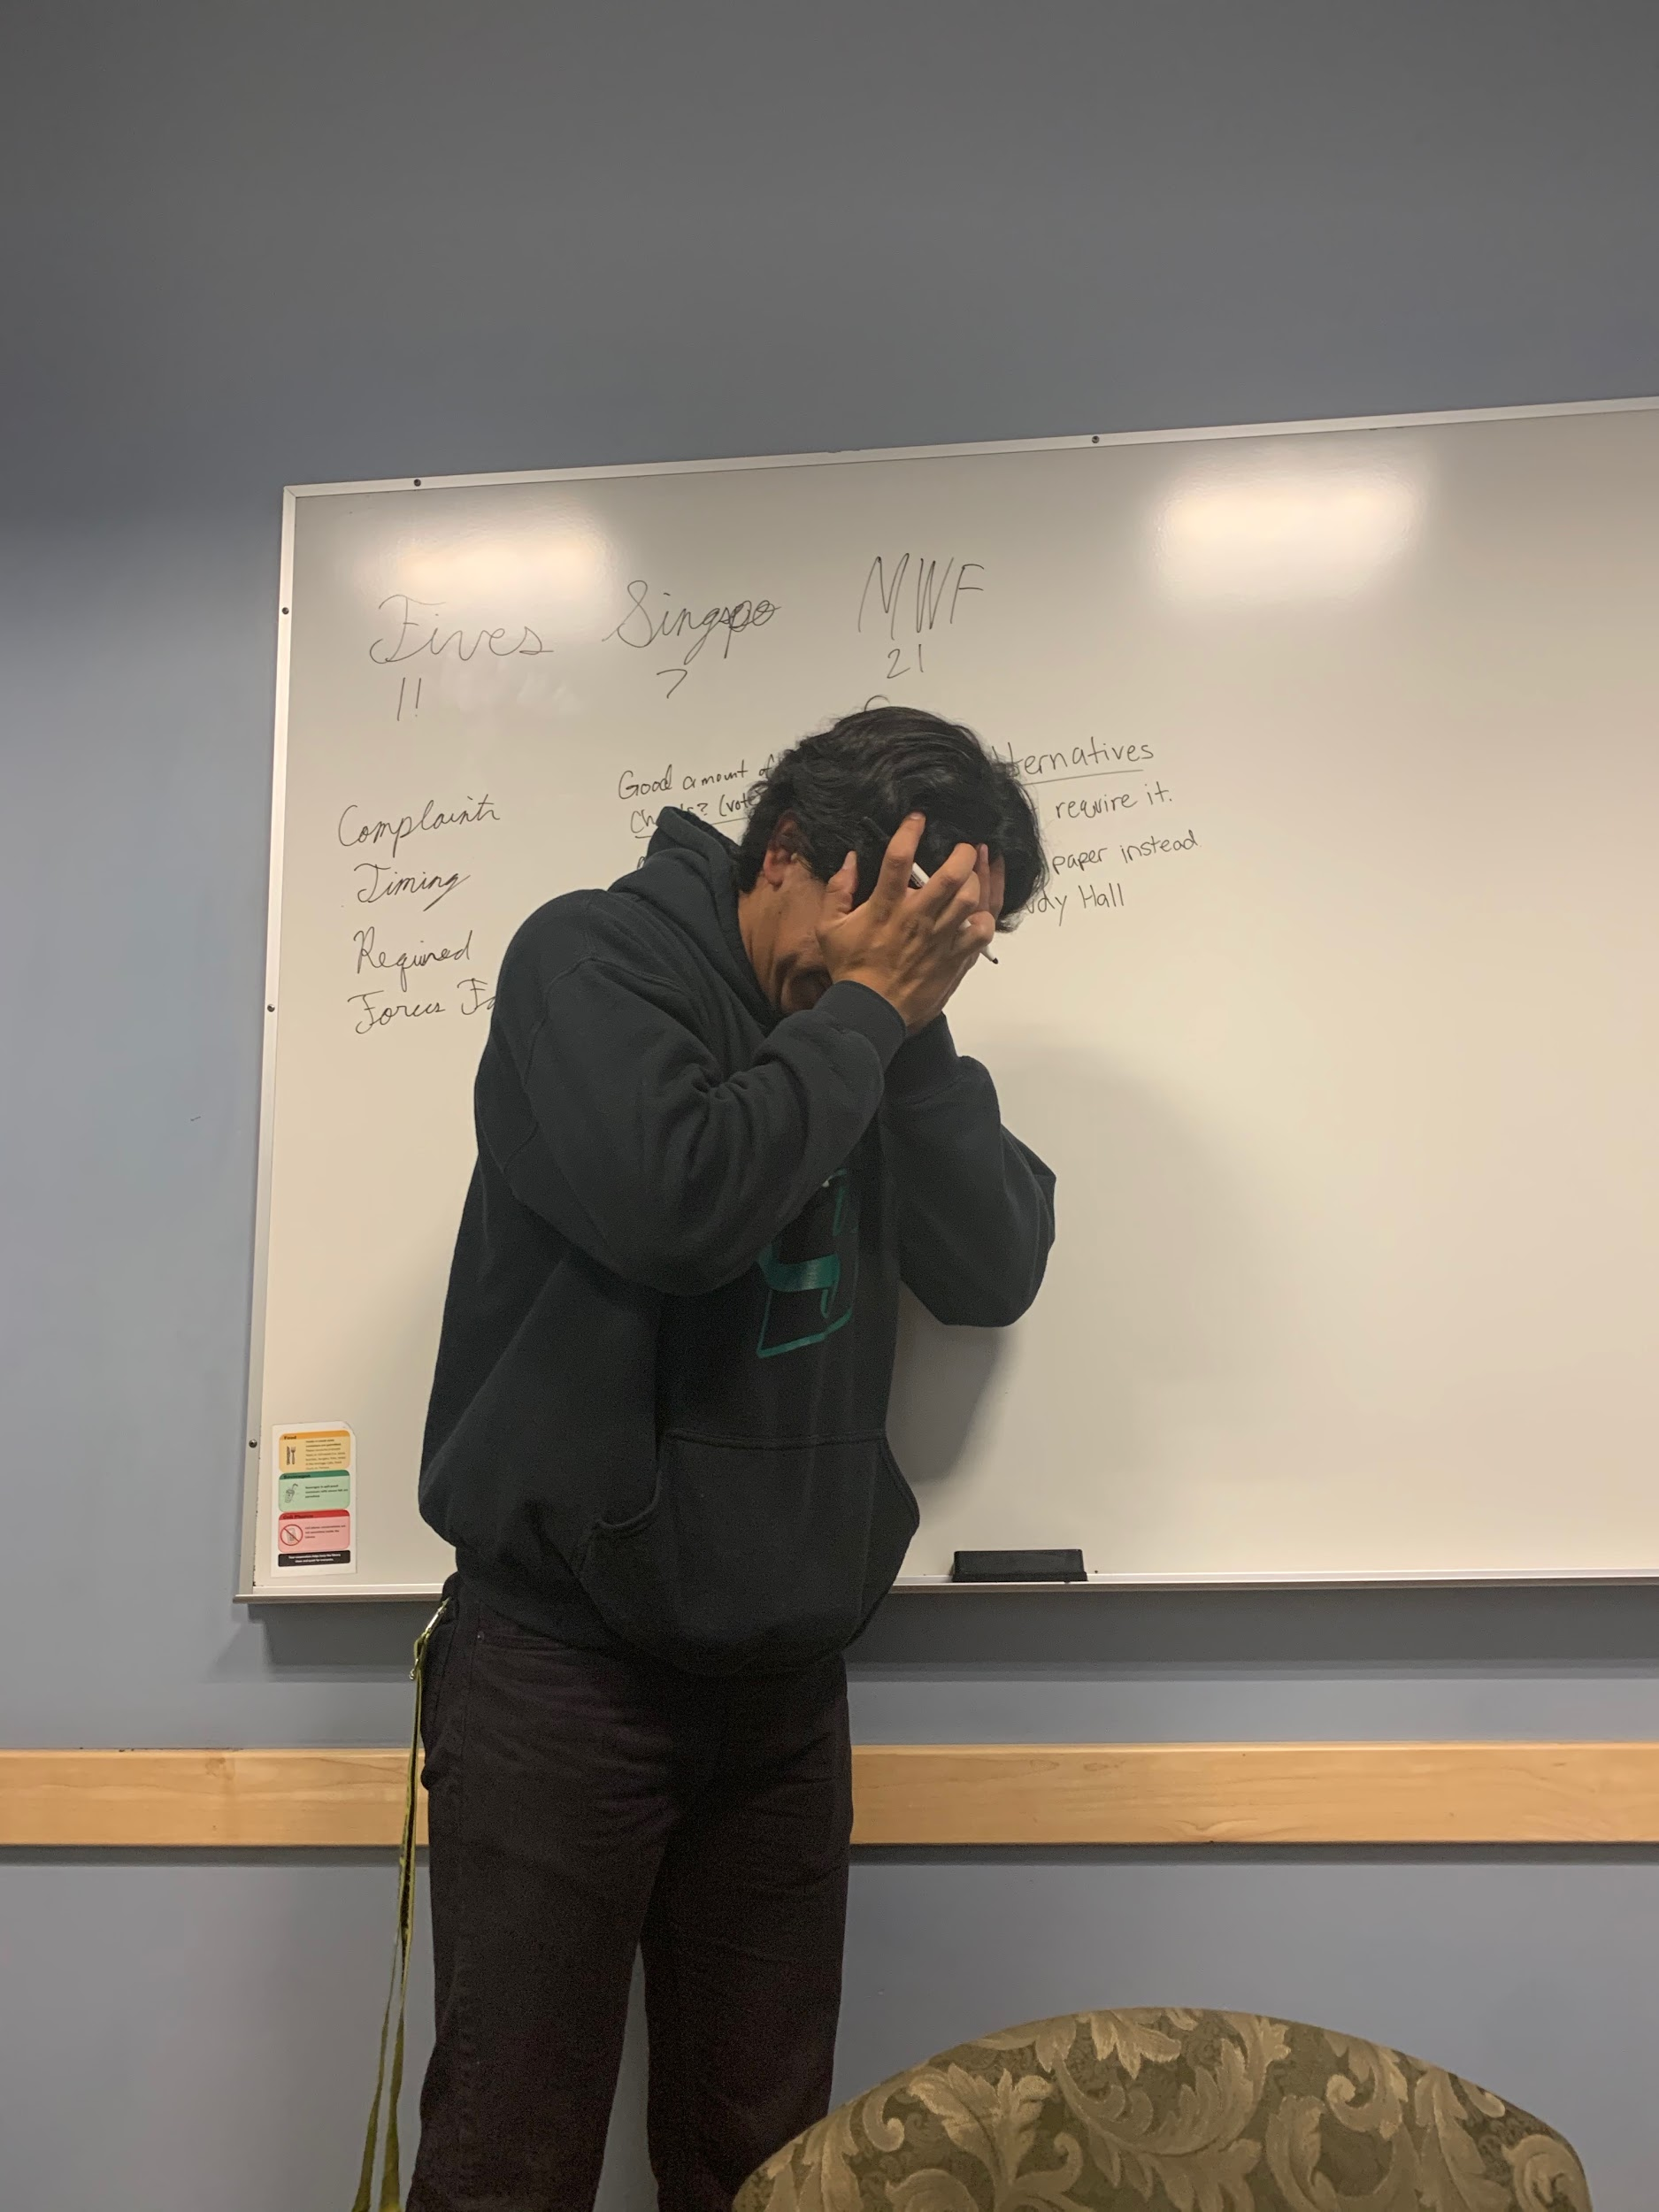
Step 2: Interpretation
Students feel forced
Students like to go to the shortest chapels (Fives)
No one mentioned going to Afterdark
Students don’t like the content
Notes:
Looking at the data, many of the students didn’t necessarily hate chapel but they acknowledged some of the problems that they had with it.
Many felt as though they were being forced to seek God in certain ways or to listen to some viewpoints that they did not agree with.
With this in mind many just went to fives because it is the shortest chapel
No one from the survey mentioned that they went or liked going to after dark.
This might be because of the small sample size but it shows that timing and convenience play a lot when it comes to when they go.

Slide 6
Step 2: Interpretation
Problems:
Timing
Forced faith
Lack of quality
Notes:
Timing, about the scheduling
Forced faith, because it is REQUIRED
Lack of quality, content is repetitive like fives, some don’t have full band worship
No one said afterdark
Most said either MWF or Fives
With singspo being the least

Slide 7
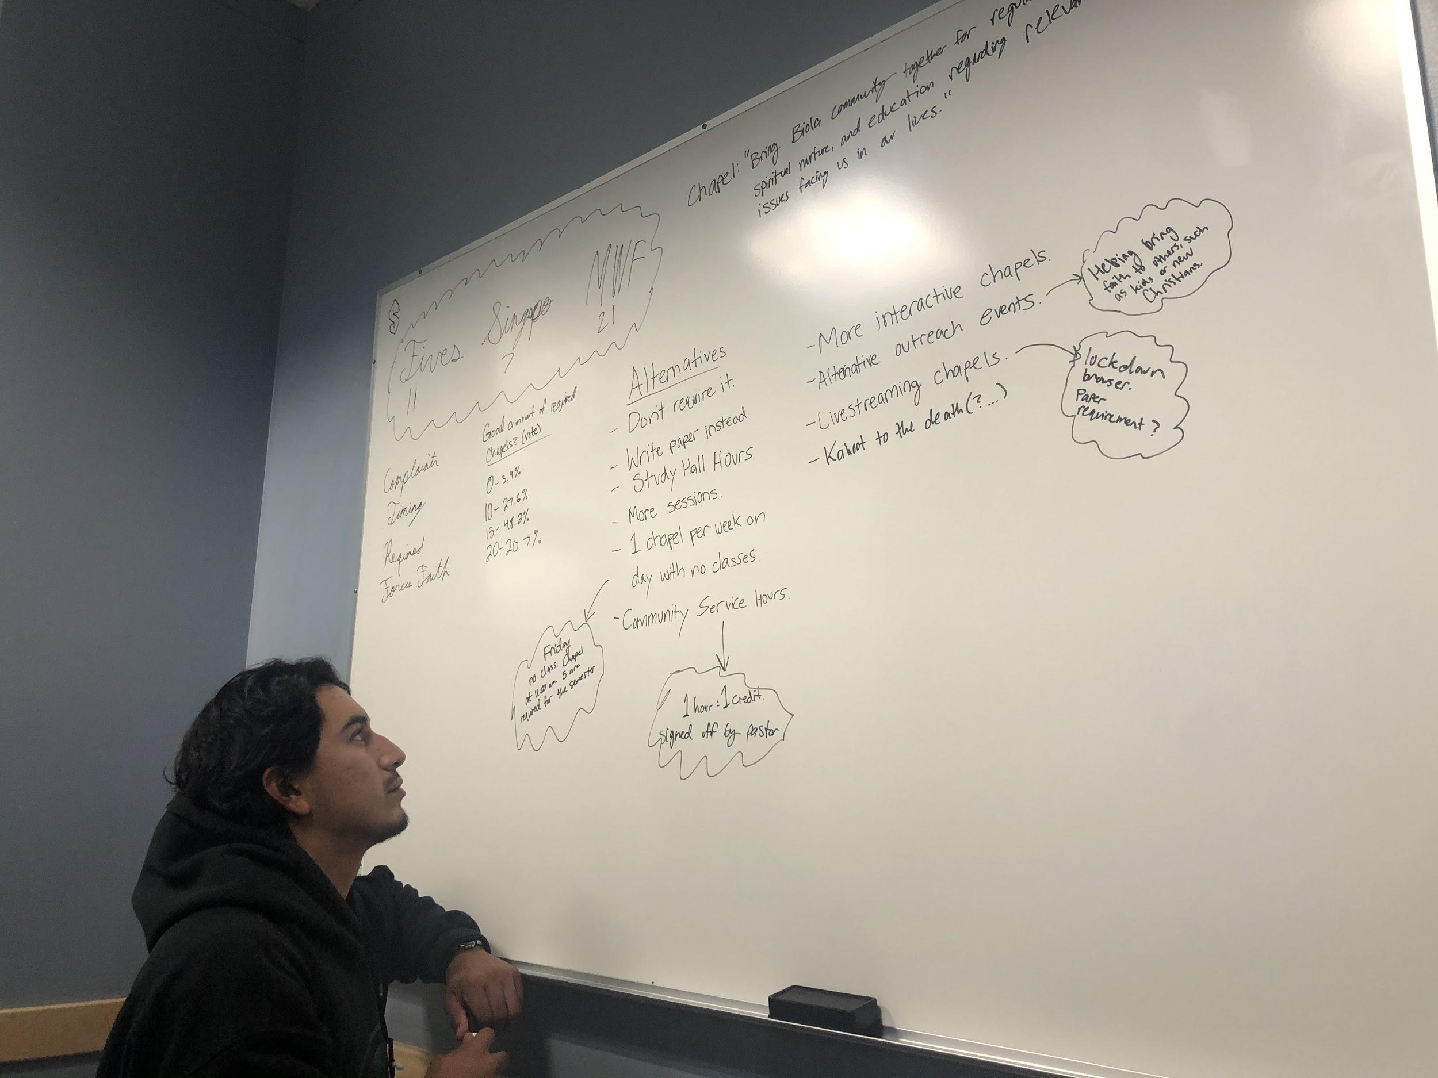
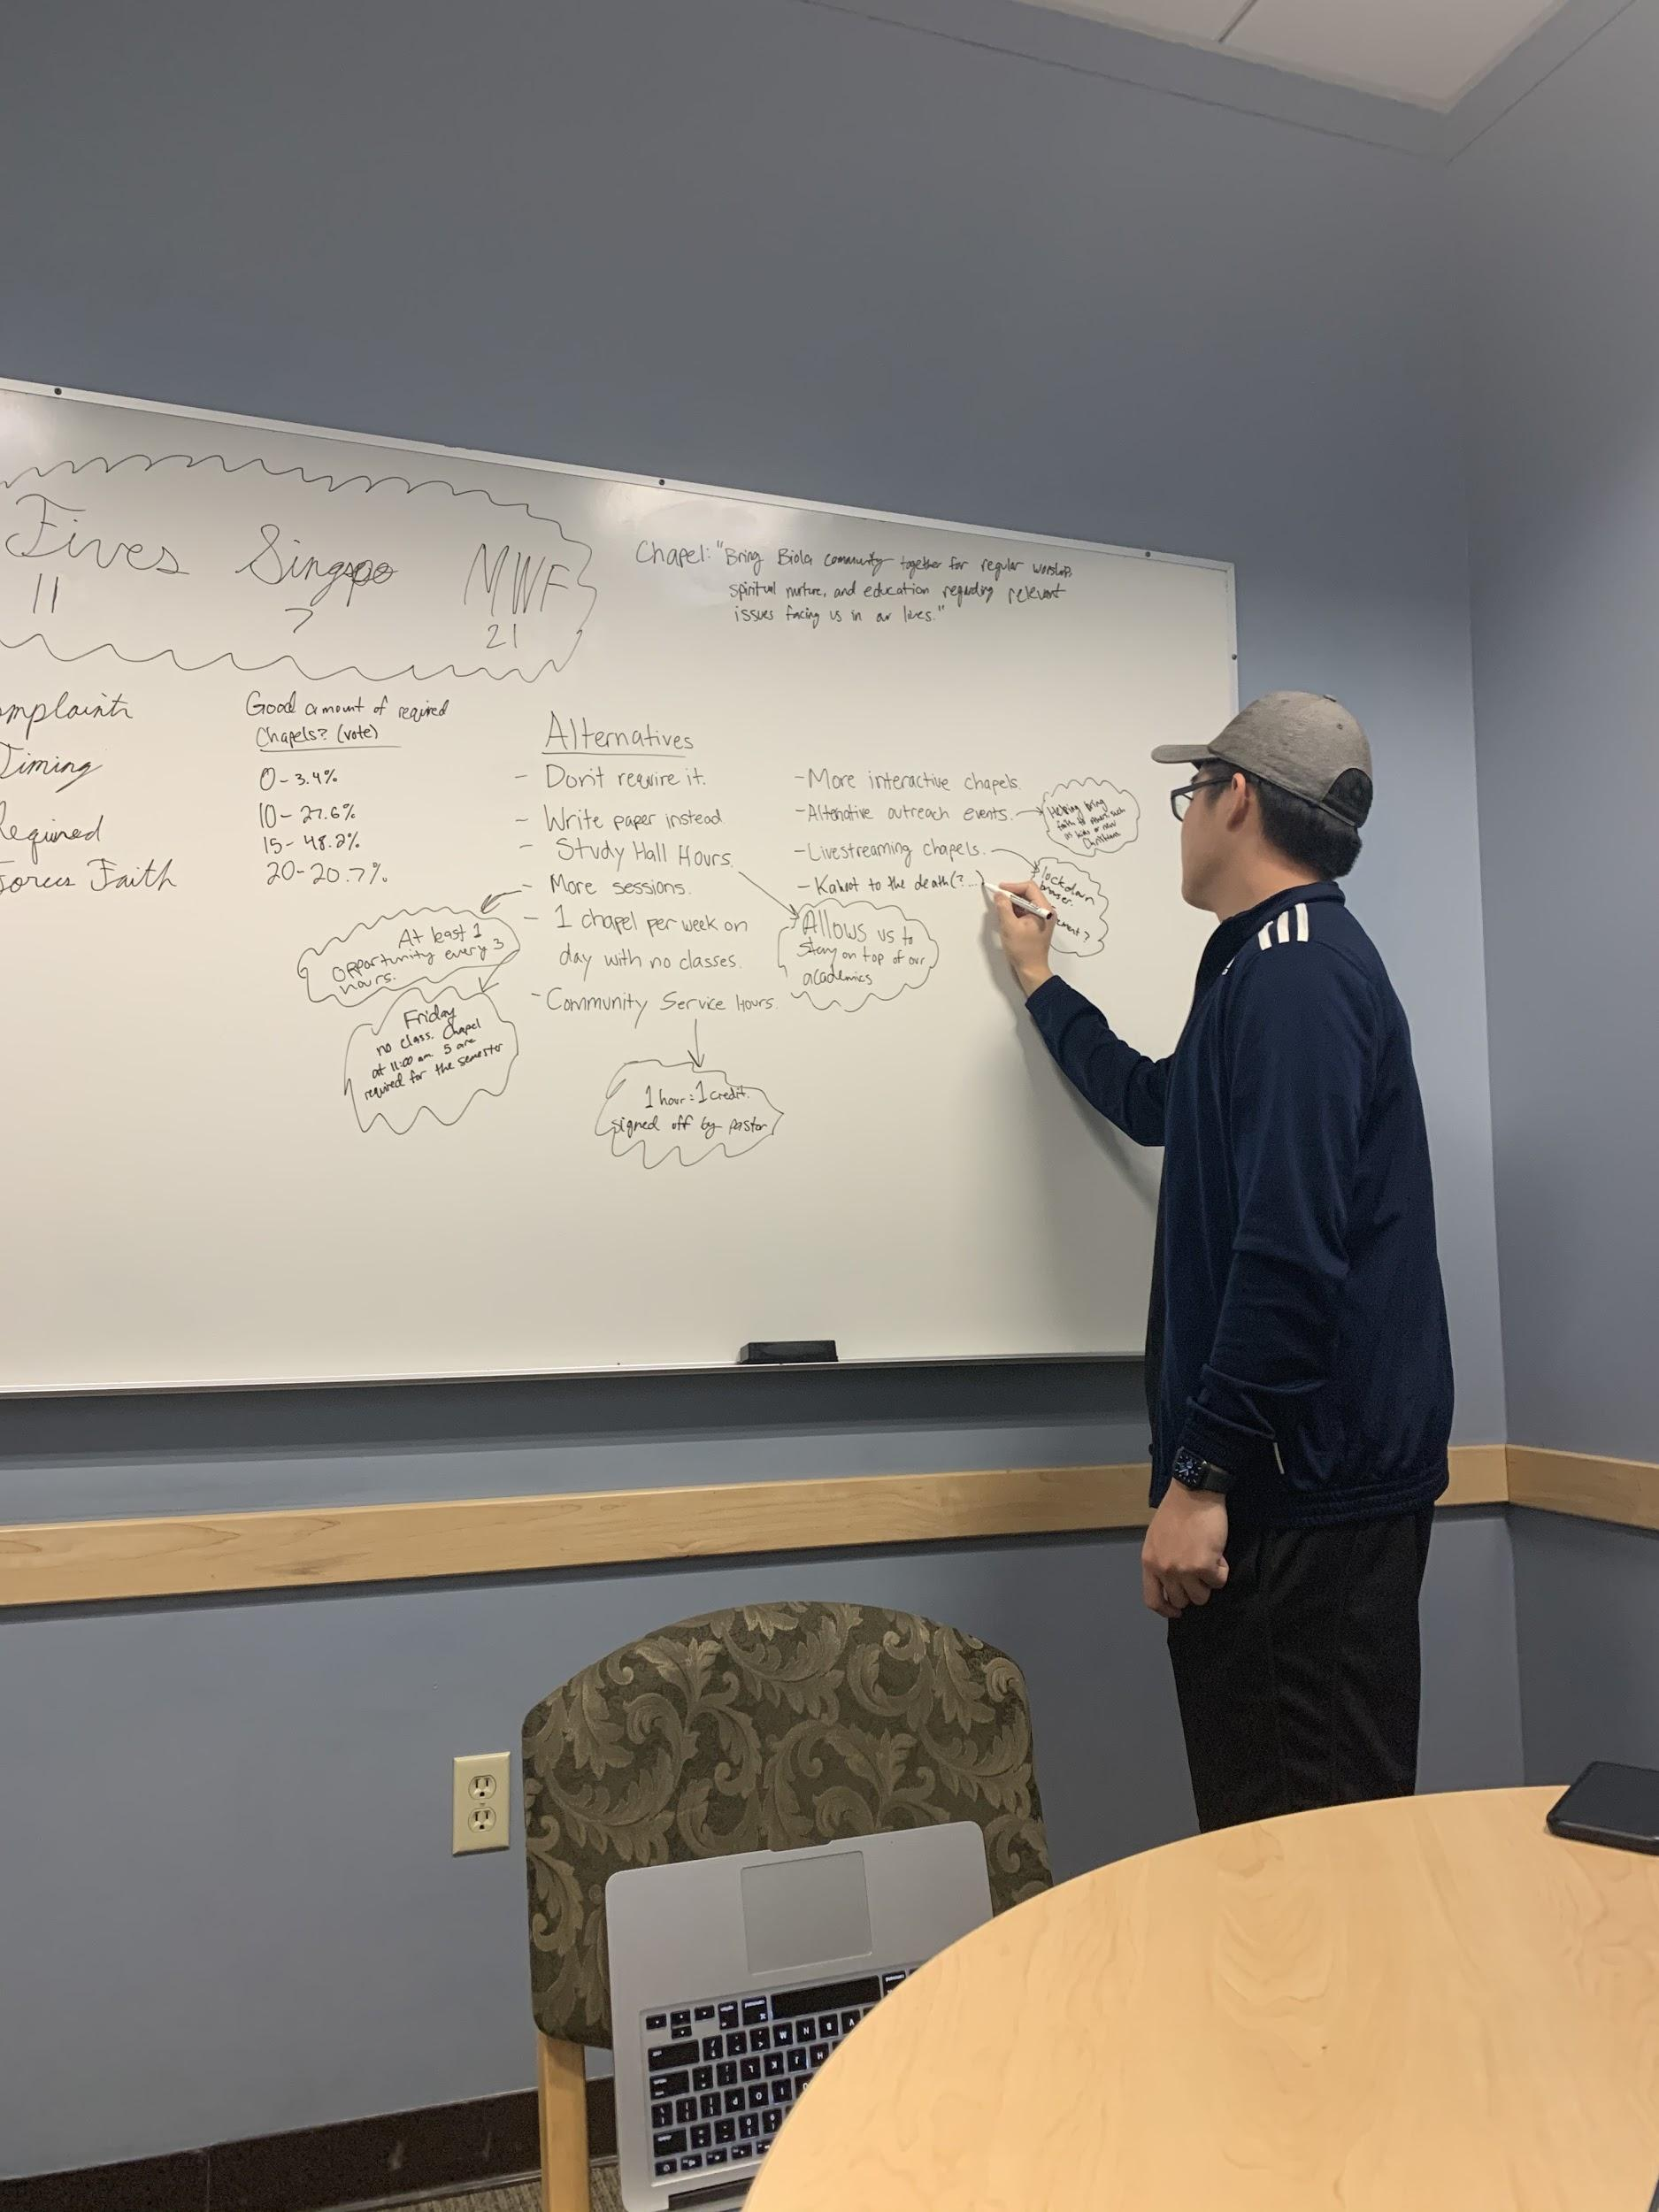
Step 3: Ideation
Notes:
Mention how we used IDEO’s 7 rules of brainstorming
Defer judgment
Encourage wild ideas
Build on the ideas of others
Stay focused on the topic
One conversation at a time
Be visual
Go for quantity.

Slide 8
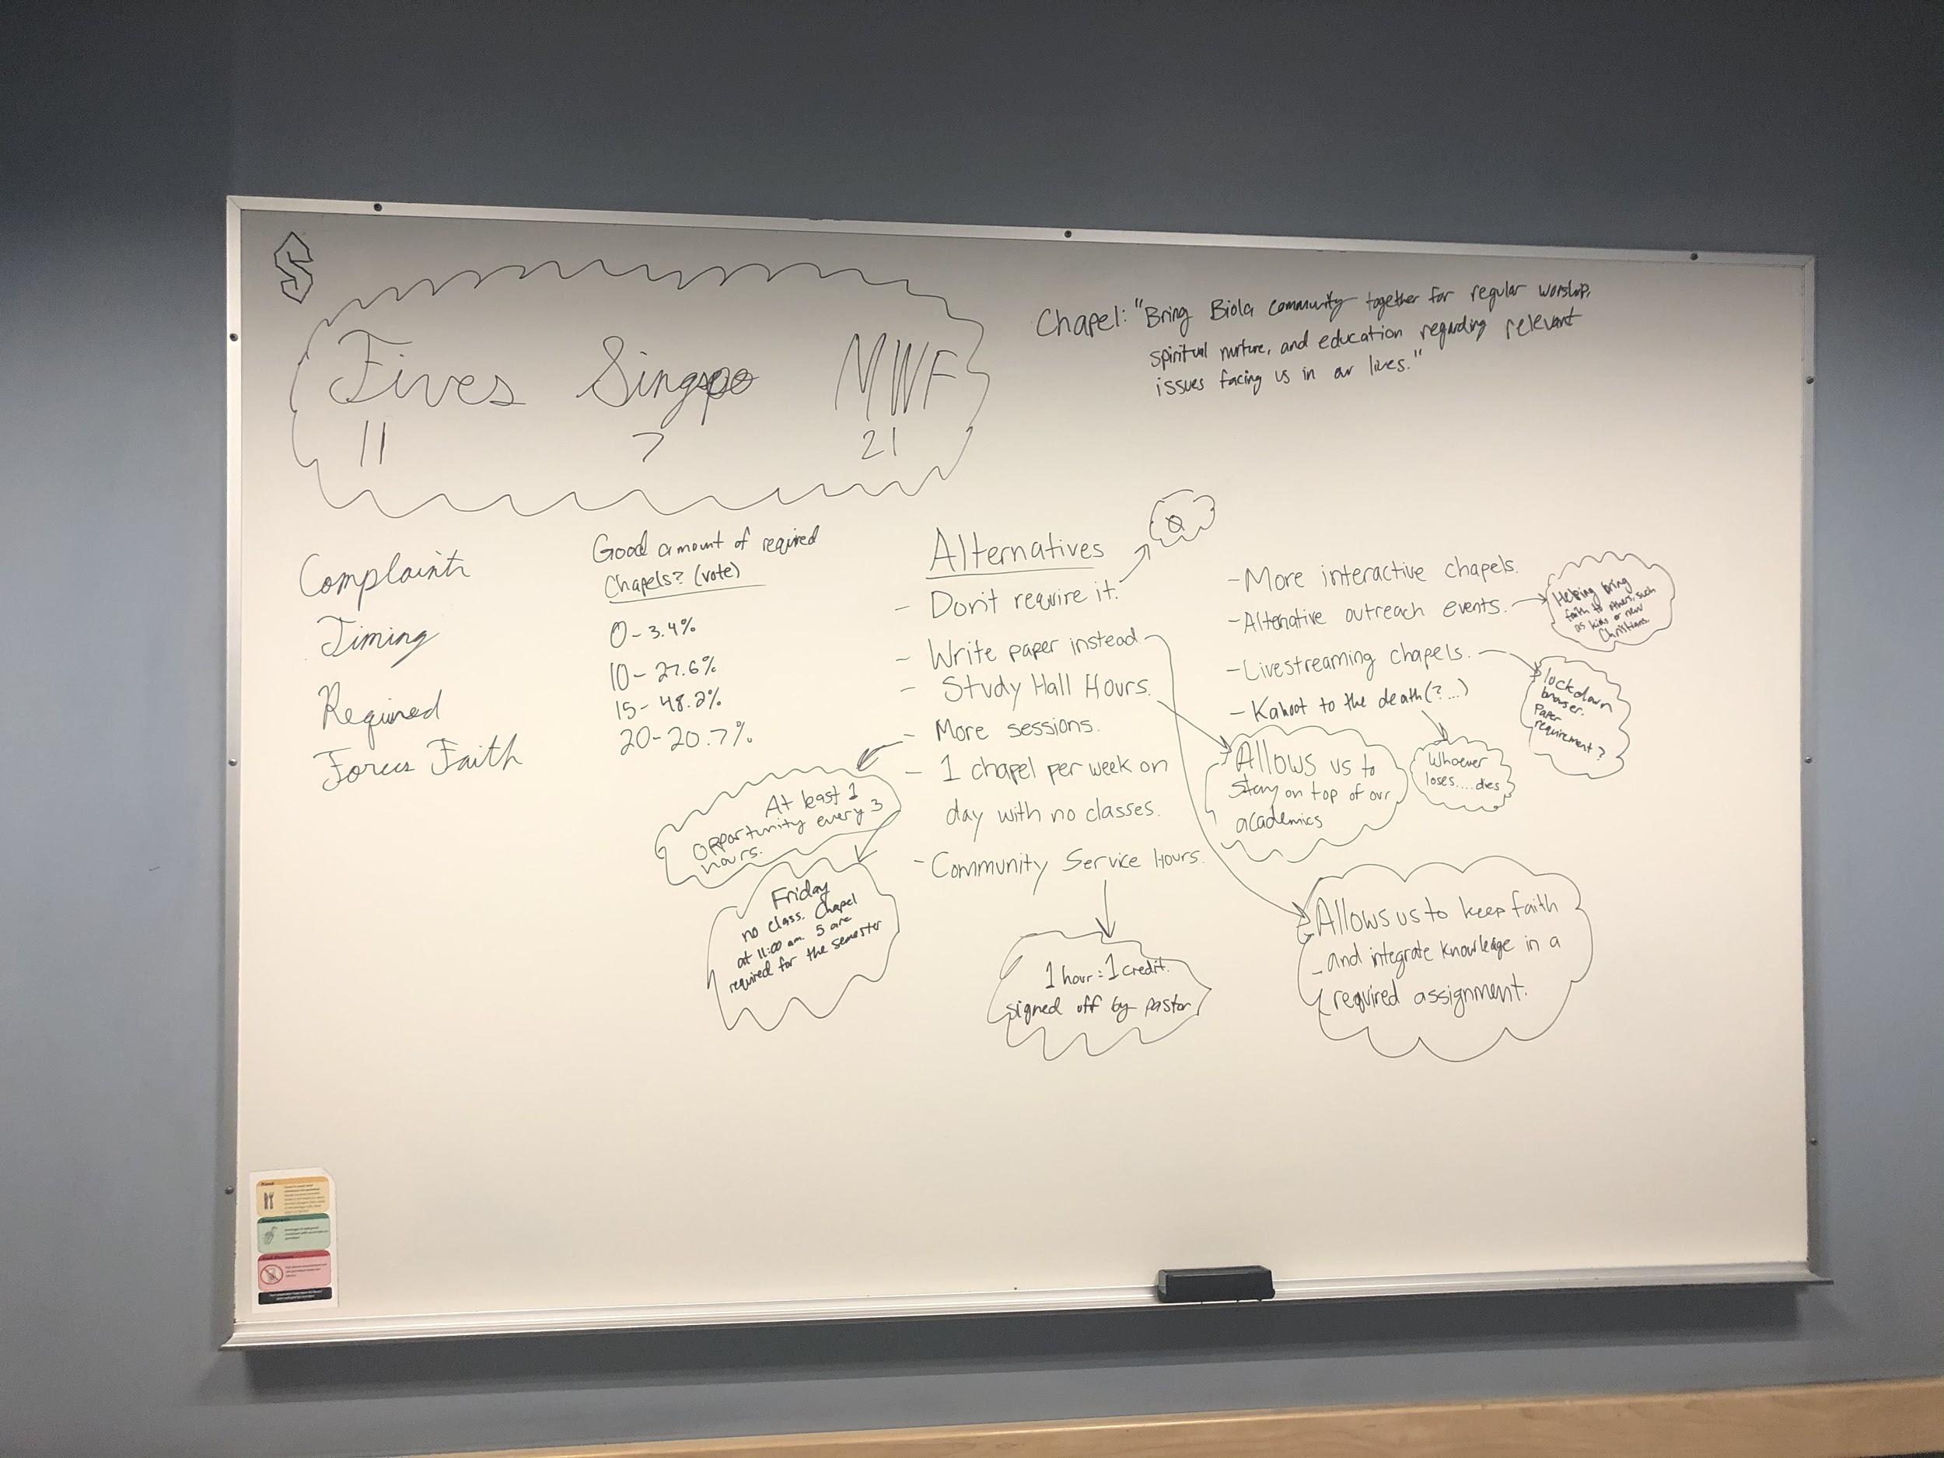
Step 3: Ideation

Slide 9
Step 3: Ideation
Alternatives to change/replace chapel credits?
Fun biblical activities
Live streams and reflections
Bible Study requirements
Volunteer hours

Slide 10

Step 3: Ideation
Focus on how to improve in:
Flexibility
Accessibility
Quality

Slide 11
Step 3: Ideation
Flexibility and Accessibility
Specific time slots for chapels
  Afternoon time slot when most students are on campus
  Remove all class times specifically for chapel
Live streaming with reflection
  Allows for easy access to chapel and proof of attention
Notes:
Jeffrey will mention lockdown browser in Evolution

Slide 12
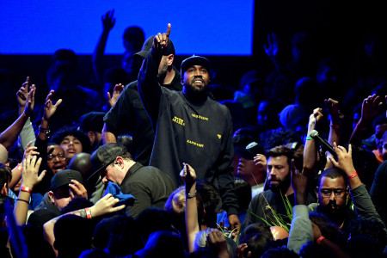
Step 3: Ideation
Quality
Headline big speakers
  Awareness of who is speaking
Big spotlight chapel

Slide 13
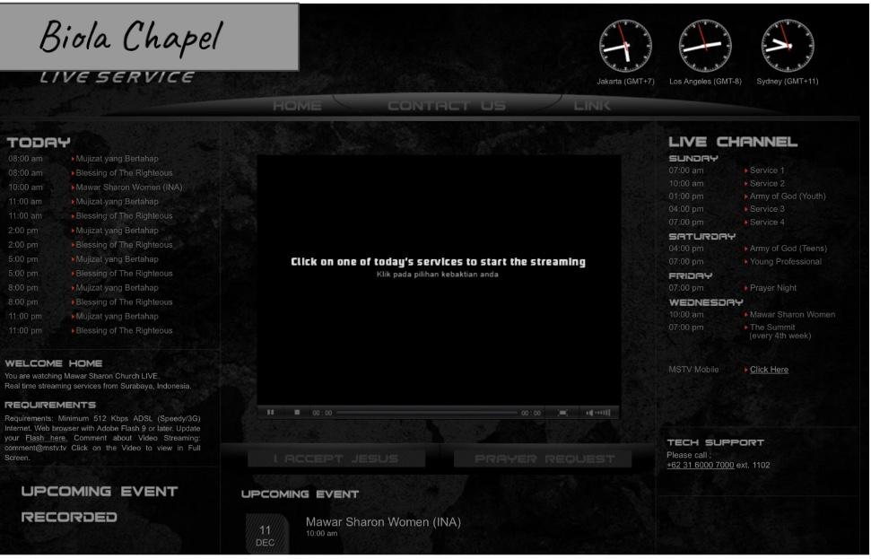
Step 4: Experimentation
Streaming
Reflection papers
Bigger name guest speakers
Notes:
We made prototypes and got feedback
Made a streaming site but we started simple by using
youtube live or instagram live
Asked my pastor who already has a streaming site about it
Also asked friends, biola students about reflection papers and how they feel
Thought of how to pay bigger

Slide 14
Step 4: Experimentation
Problems
Students can easily exit streaming site
Students can take advantage of streaming
Too many reflection papers
Budgetary issues
Notes:
take advantage:
Students who are in biola can just stream if they are lazy
Students can stream in class
Reflection paper
Need people to read
How to grade depth if they are actually listening or not
Main problem is too many
Bigger guest speakers need more budget, Solution is to reduce amount of chapel and get more budget

Slide 15
Step 5: Evolution
“How might we make chapel more accessible?”
Notes:
Reframe challenges and iterate solution from experimentation

Slide 16
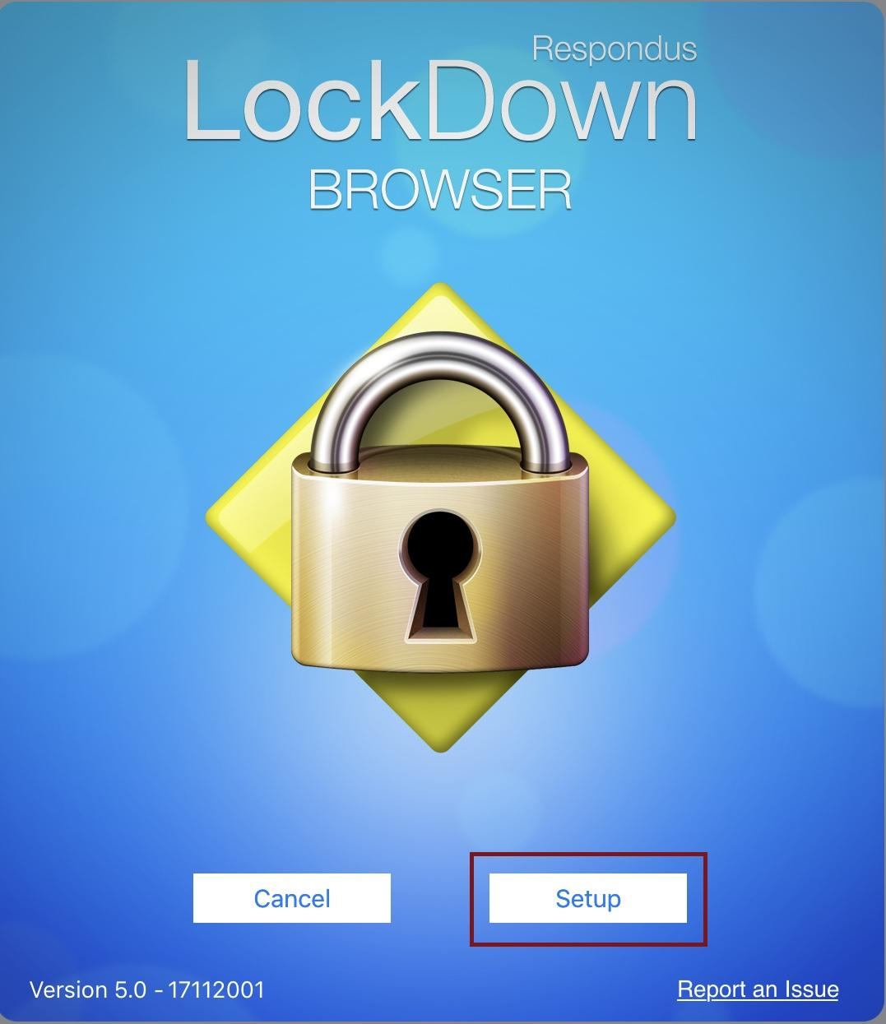

Step 5: Evolution
Notes:
Add GPS, so that if 10 miles or more, streaming is allowed
So that students who are actually in Biola cannot stream, only those who are far from biola
Lockdown browser so cannot exit

Slide 17
Step 5: Evolution
“How might we fit chapel into student’s schedules?”
“How might we create more inviting chapels?”
Notes:
Again we wanted to reframe the challenge with the how might me question and iterate solution

Slide 18
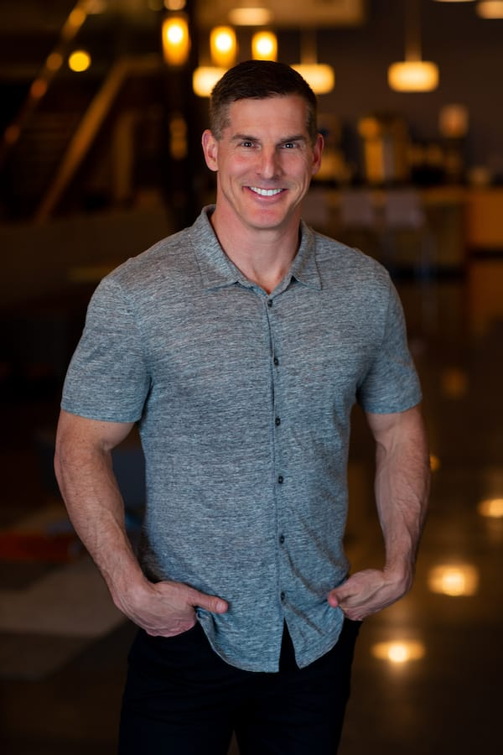

Step 5: Evolution
Less chapels per week
Shift AfterDark to 5 o’clock
Specific time for Chapels only
Notes:
Less chapels means more budget for guest speakers
Decrease quantity, increase quality
Big spotlight chapel where no class for any students so all can come
Treat it like Sabbath for Biola (where everyone rest and have chapel together)
Wednesday 5 oclock for this before dark
Monday morning 9:30 Tuesday 5 wednesday 5 thursday 9:30 Thursday at noon Sinspo on sunday

Slide 19


Slide 20
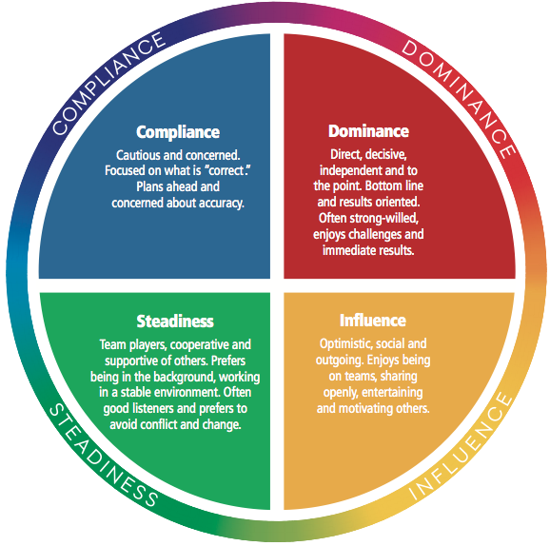
DISC
Guillermo:S
Kenny:S
Jeff:C
Elijah:I

Slide 21
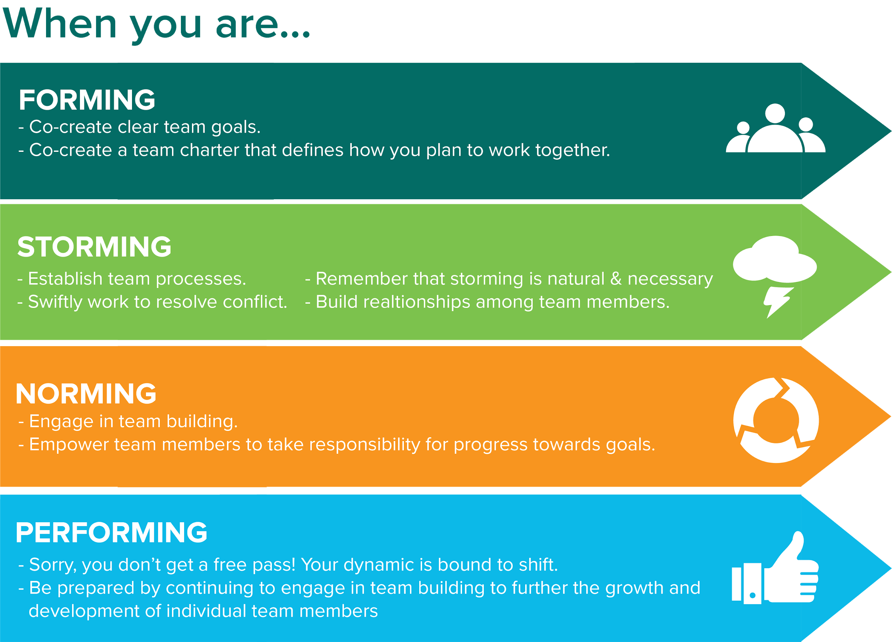
Team Dynamics

Slide 22
Faith Integration
Hebrews 10:24-25
“And let us consider how to stir up one another to love and good works, not neglecting to meet together, as is the habit of some, but encouraging one another, and all the more as you see the Day drawing near.”
Matthew 12:34
You brood of vipers! How can you speak good things, when you are evil? For out of the abundance of the heart the mouth speaks

Slide 23
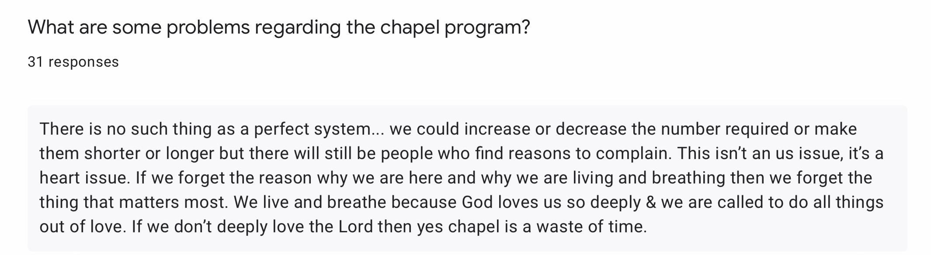
Faith Integration

